Slide 1

Speaker Info
Please use the intro slide
Call out and thank the sponsors on slide 2 by name
Use of the 2 speaker profile pages
Encourage the use of the #Hashtag #ScottishSummit2021 on all social media
Use the thank you slide and make sure to tell everyone that your session will be uploaded to YouTube after 14 days
Try and use as a many of the slide templates as you can as these have been made for accessibility and can be helpful to people who may require additional assistance.
Use the Accessibility checker on your slide deck Improve accessibility with the Accessibility Checker - Office Support (microsoft.com)
Upload your slide deck to the app after your session is complete.

Slide 2



#ScottishSummit2021
Rob Sewell
Controlling Permissions to Azure SQL Database and Azure SQL Managed Instance using Excel and Azure DevOps

Slide 3
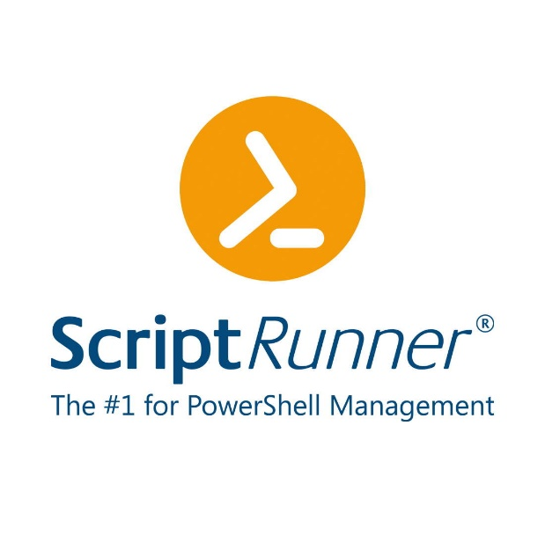





Our Sponsors

Slide 4

Rob
Sewell
@sqldbawithbeard
Microsoft MVP
blog.robsewell.com
beard.media\book

Slide 5

Sewells Consulting Ltd
Bearded Consultant Automator
Trainer
Dual MVP
beard.media\book
@sqldbawithbeard
blog.robsewell.com
Rob Sewell
Microsoft MVP

Slide 6

What Is The Problem ?
Photo by Andrey Metelev on Unsplash

Slide 7
What Is The Problem ?
Automate a solution to make it easy for the Operational Team to control permissions to the Azure SQL Database and Azure SQL Managed Instance estate
Photo by Andrey Metelev on Unsplash

Slide 8
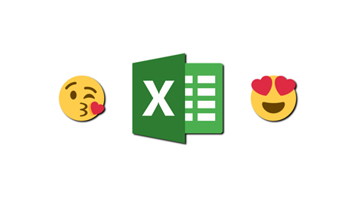
Also
“We’d Really like to use Excel”

Slide 9
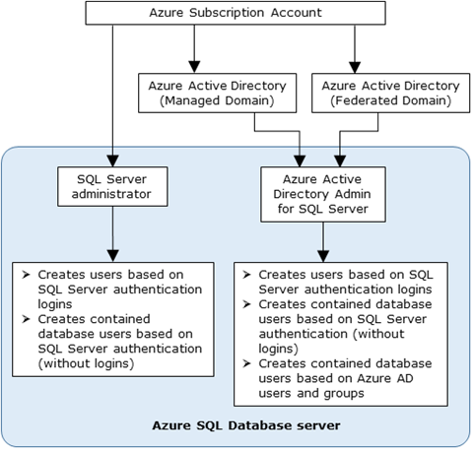
Creating Azure SQL Database Users
Admin Accounts can create
https://docs.microsoft.com/en-us/azure/azure-sql/database/authentication-aad-overview

Slide 10


Creating Azure SQL Database Users
https://docs.microsoft.com/en-us/azure/azure-sql/database/authentication-aad-overview

Slide 11

Only One Option
Photo by Olli Kilpi on Unsplash

Slide 12

Creating an AAD Contained Database User
We have an automated Infrastructure as Code deployment
We want an automated Permissions as Code pipeline
We don’t want manual intervention
Photo by Thirteen .J on Unsplash

Slide 13
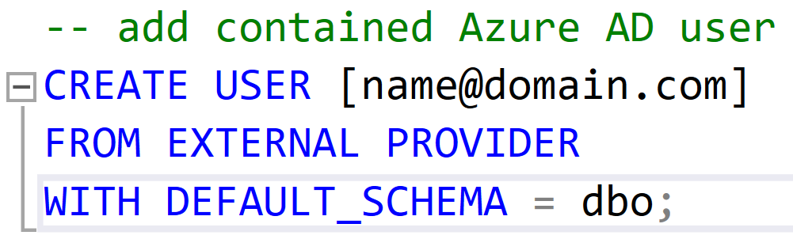
Creating an AAD Contained Database User
Only connections established with Active Directory accounts can create other Active Directory users

Slide 14

Requirements
Apply Permissions using SPN
Azure SQL Server Identity
Active Directory Admin
Directory Readers Role
Azure DevOps Pipeline
Permissions in Excel Sheet
Photo by Kelly Sikkema on Unsplash

Slide 15
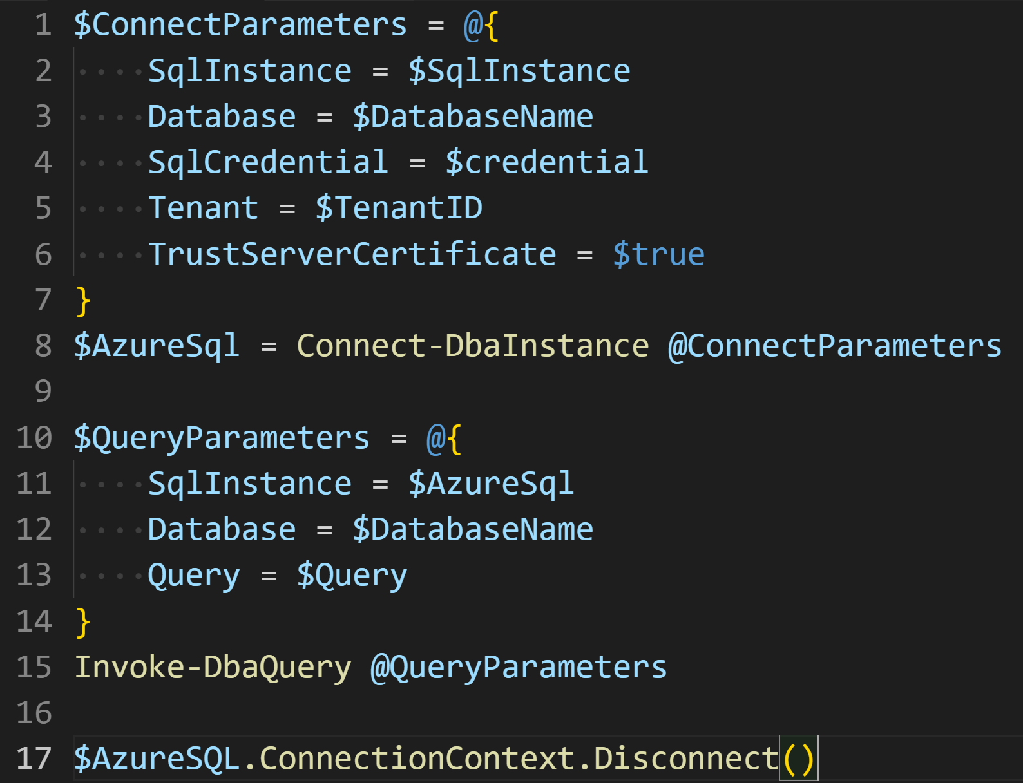
Use dbatools https://dbatools.io
Need to login as the SPN to run the T-SQL

Slide 16
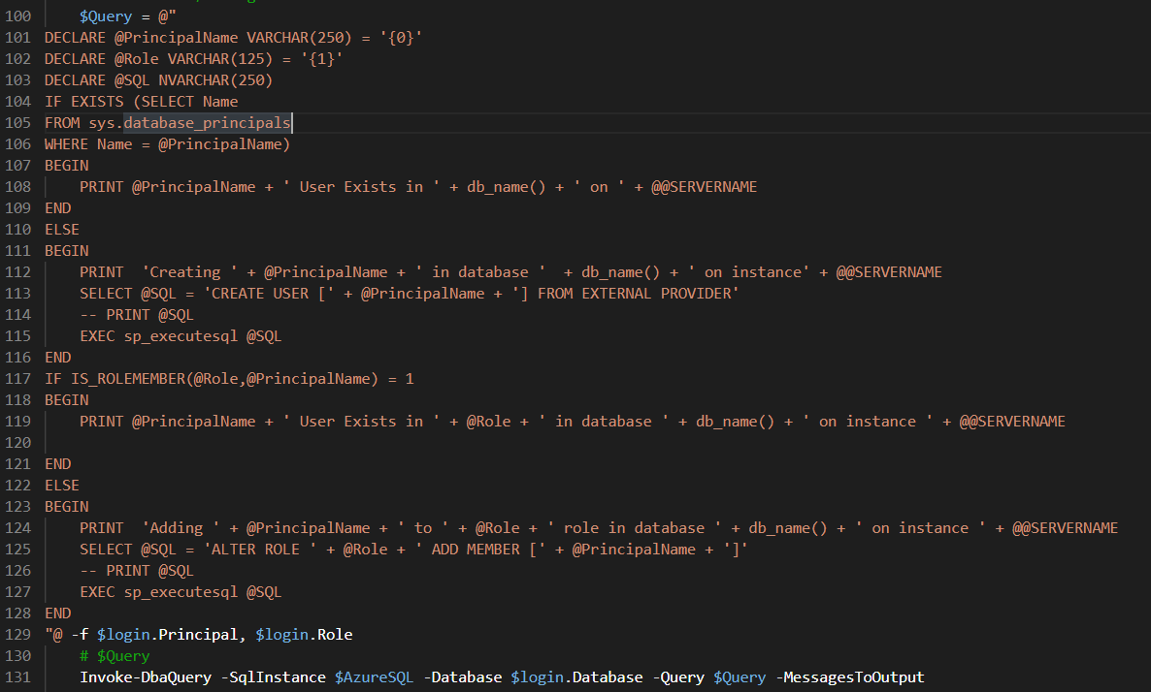
ad

Slide 17

Requirements
Apply Permissions using SPN
Azure SQL Server Identity
Active Directory Admin
Directory Readers Role
Azure DevOps Pipeline
Permissions in Excel Sheet
Photo by Kelly Sikkema on Unsplash

Slide 18
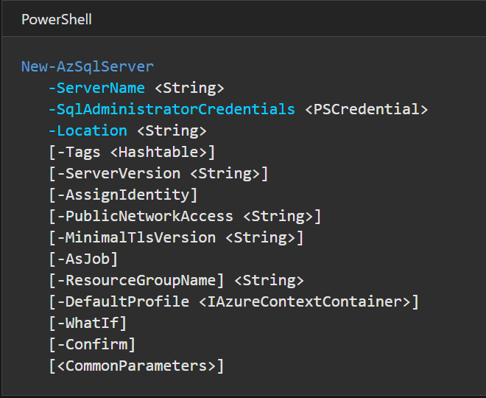
Need the SQL Server to have an Identity
https://docs.microsoft.com/en-us/powershell/module/az.sql/new-azsqlserver?view=azps-5.4.0

Slide 19
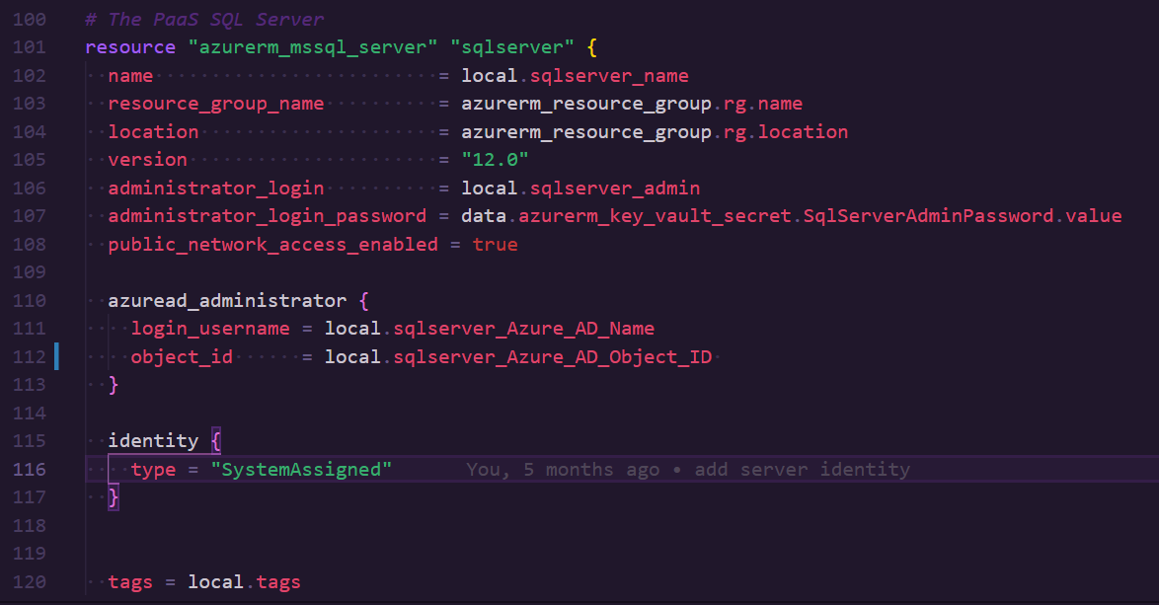
Need the SQL Server to have an Identity
https://registry.terraform.io/providers/hashicorp/azurerm/latest/docs/resources/sql_server

Slide 20
Requirements
Apply Permissions using SPN
Azure SQL Server Identity
Active Directory Admin
Directory Readers Role
Azure DevOps Pipeline
Permissions in Excel Sheet
Photo by Kelly Sikkema on Unsplash

Slide 21
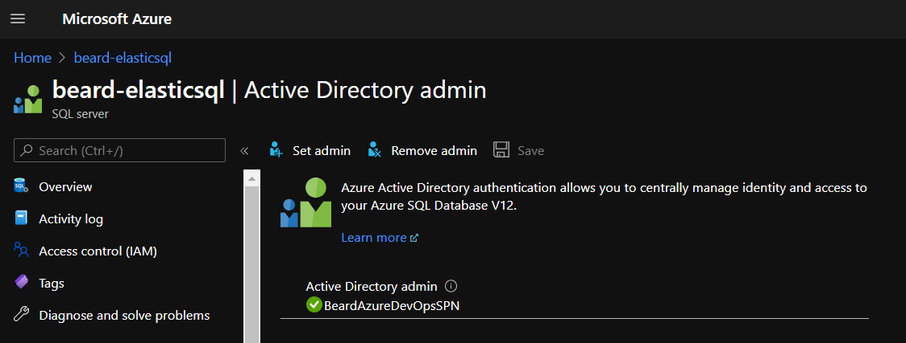
Set the Active Directory Admin

Slide 22
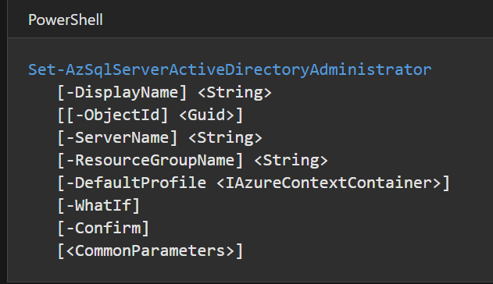
Set the Active Directory Admin
https://docs.microsoft.com/en-us/powershell/module/az.sql/set-azsqlserveractivedirectoryadministrator?view=azps-5.4.0

Slide 23
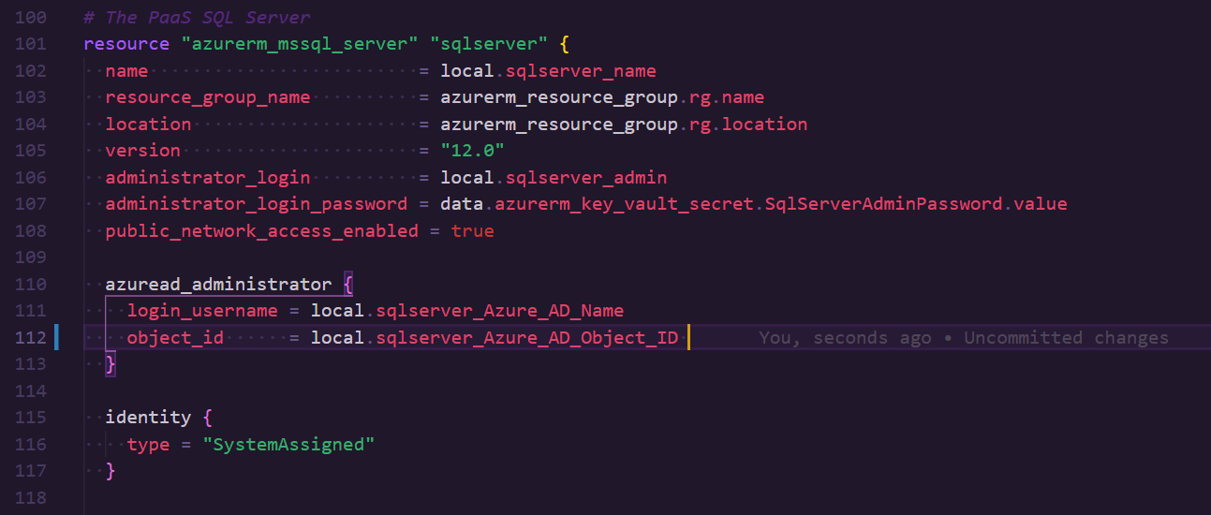
Set the Active Directory Admin
https://registry.terraform.io/providers/hashicorp/azurerm/latest/docs/resources/sql_server

Slide 24
Requirements
Apply Permissions using SPN
Azure SQL Server Identity
Active Directory Admin
Directory Readers Role
Azure DevOps Pipeline
Permissions in Excel Sheet
Photo by Kelly Sikkema on Unsplash

Slide 25
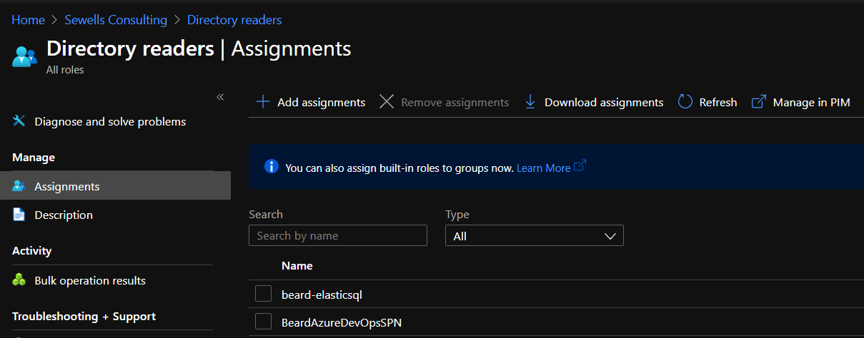
Directory Reader in AAD

Slide 26
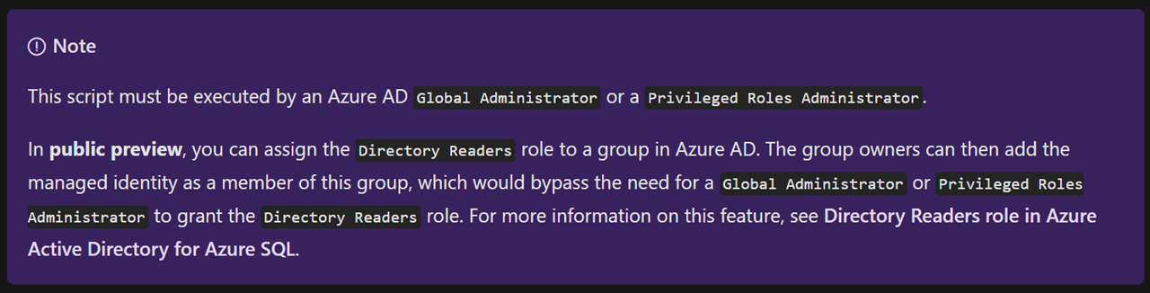
Directory Reader in AAD
https://docs.microsoft.com/en-us/azure/azure-sql/database/authentication-aad-service-principal-tutorial

Slide 27
Requirements
Apply Permissions using SPN
Azure SQL Server Identity
Active Directory Admin
Directory Readers Role
Azure DevOps Pipeline
Permissions in Excel Sheet
Photo by Kelly Sikkema on Unsplash

Slide 28
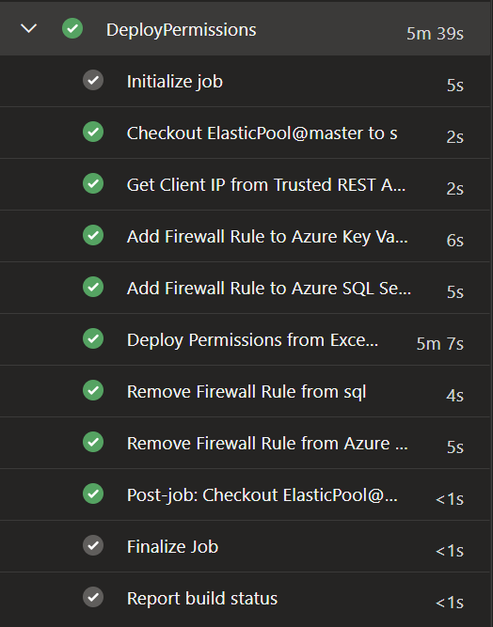
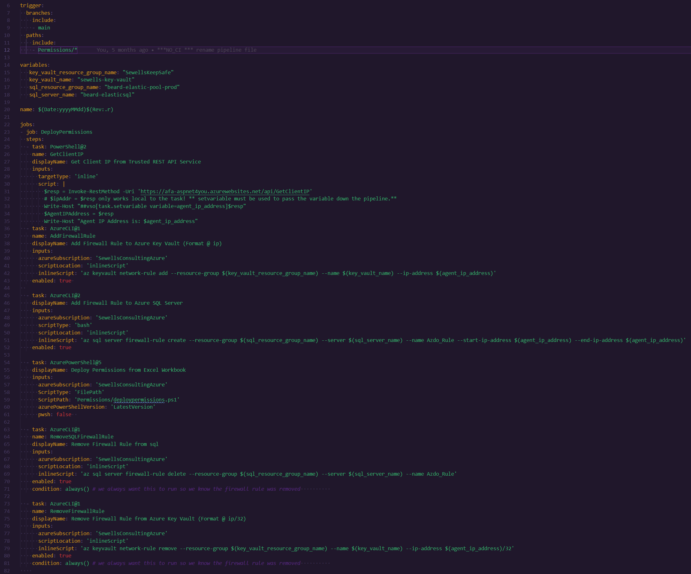
pipeline

Slide 29
pipeline

Slide 30
pipeline

Slide 31
pipeline

Slide 32
pipeline

Slide 33
Requirements
Apply Permissions using SPN
Azure SQL Server Identity
Active Directory Admin
Directory Readers Role
Azure DevOps Pipeline
Permissions in Excel Sheet
Photo by Kelly Sikkema on Unsplash

Slide 34
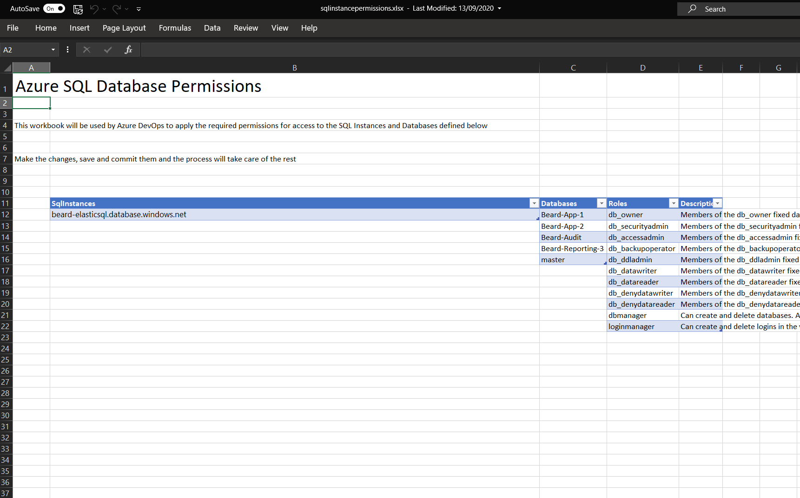
pipeline

Slide 35
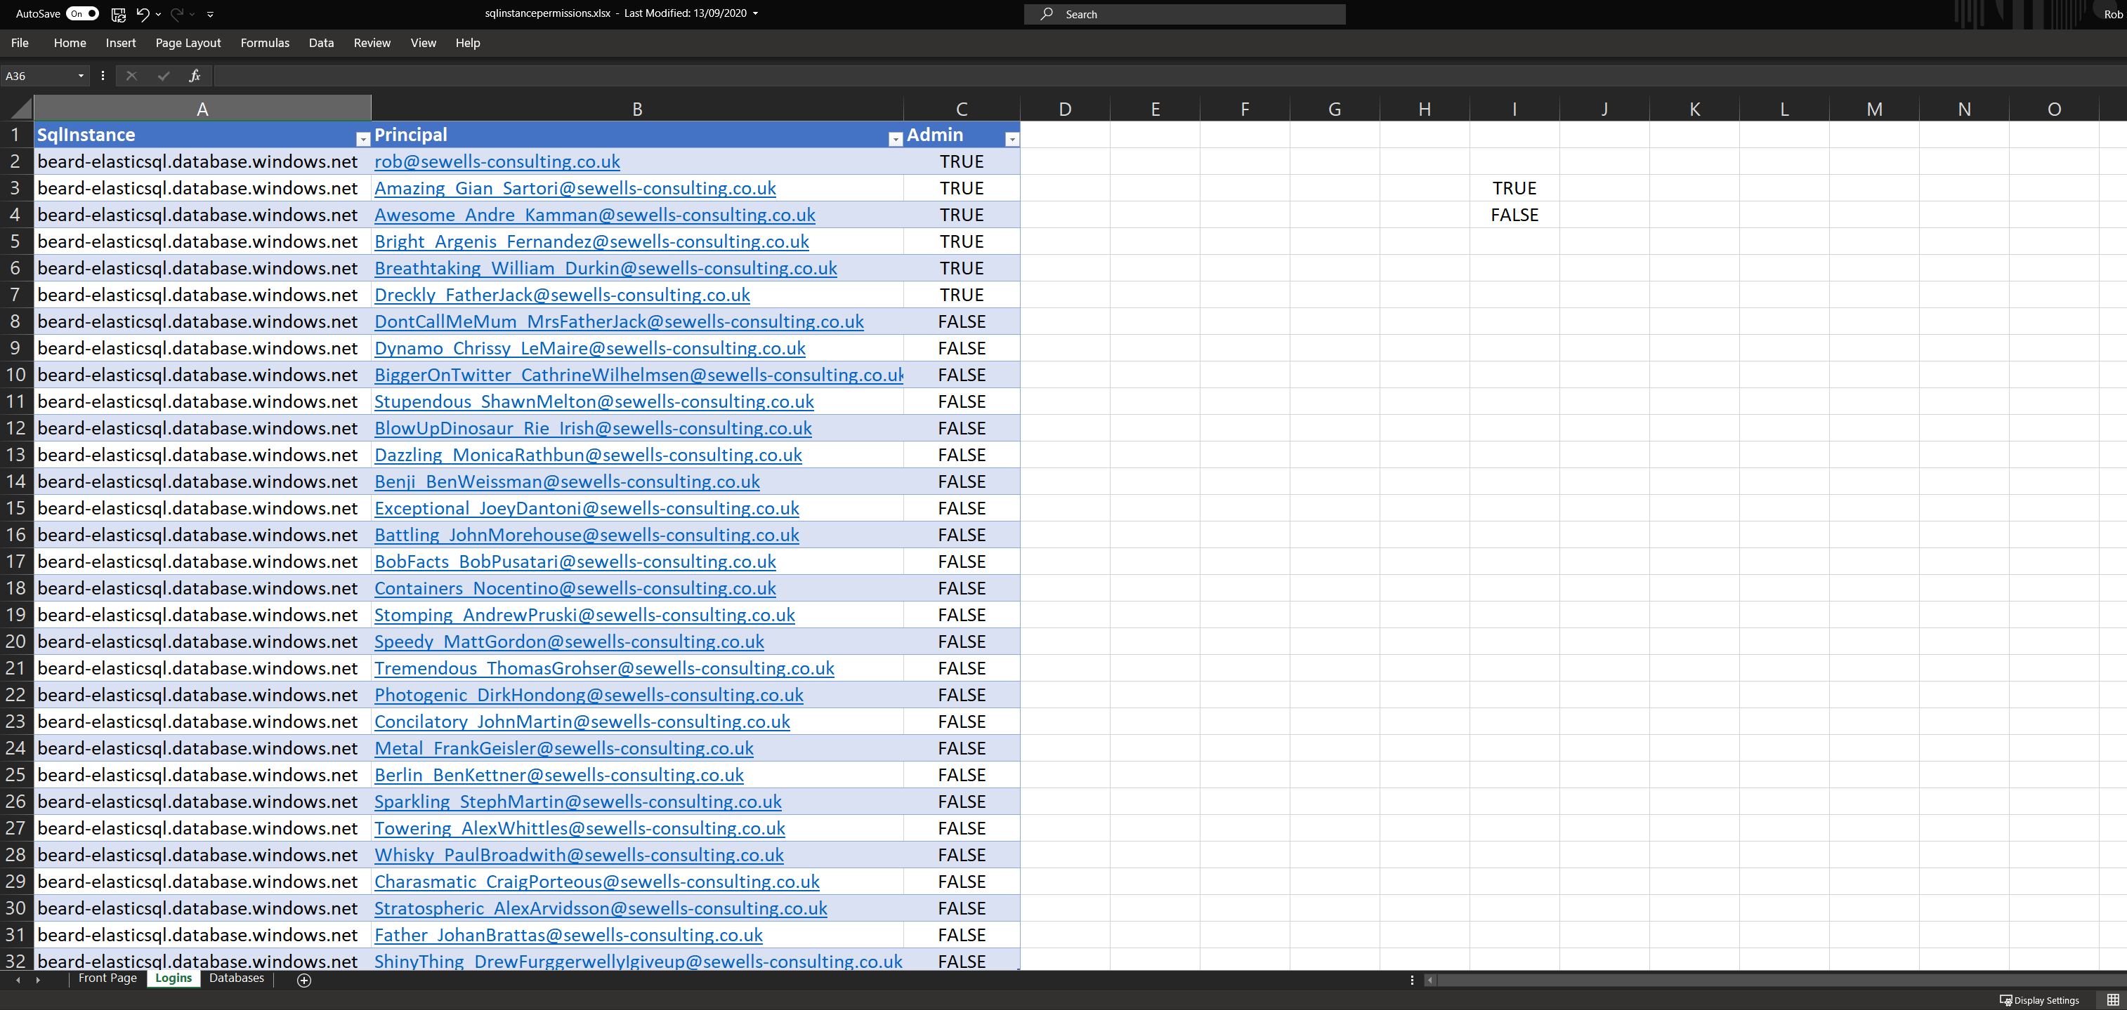
pipeline

Slide 36
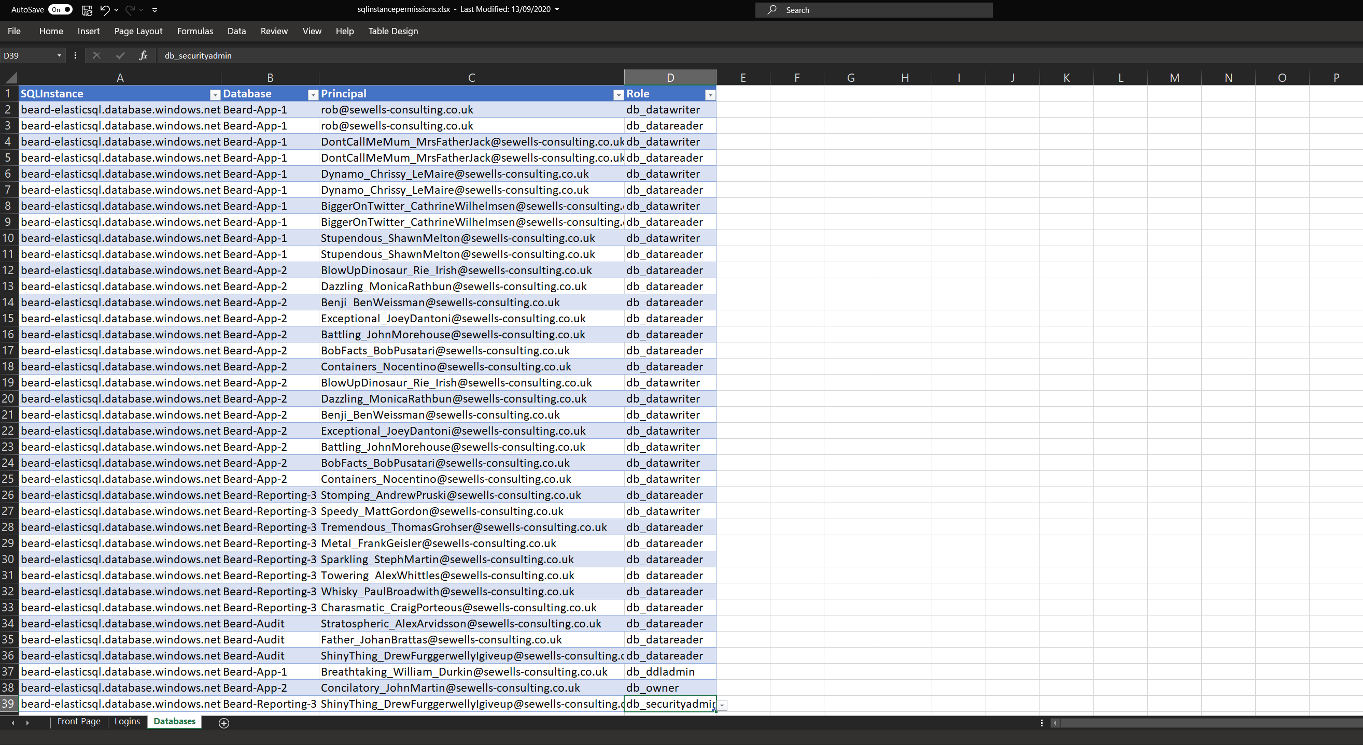
pipeline

Slide 37
Requirements
Apply Permissions using SPN
Azure SQL Server Identity
Active Directory Admin
Directory Readers Role
Azure DevOps Pipeline
Permissions in Excel Sheet
Photo by Kelly Sikkema on Unsplash

Slide 38
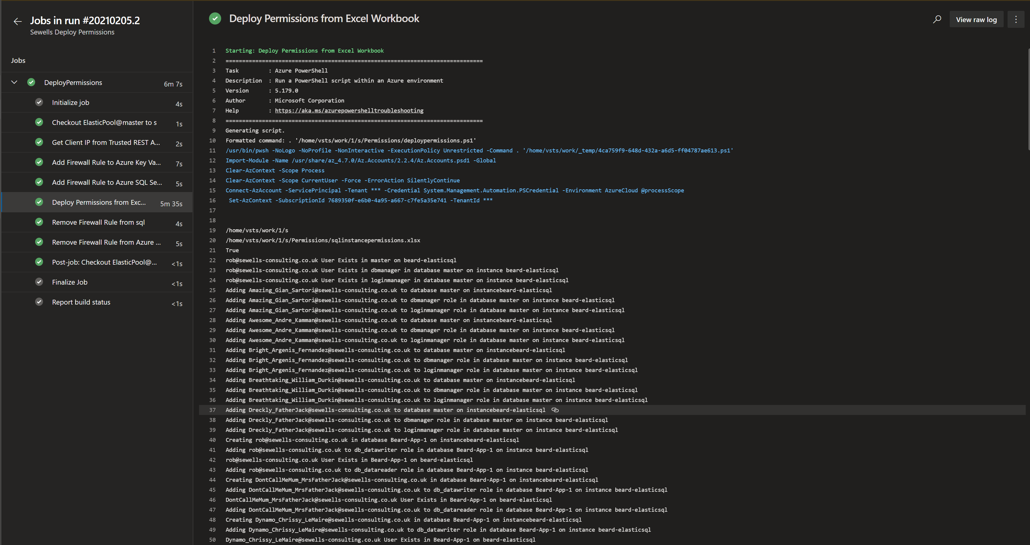
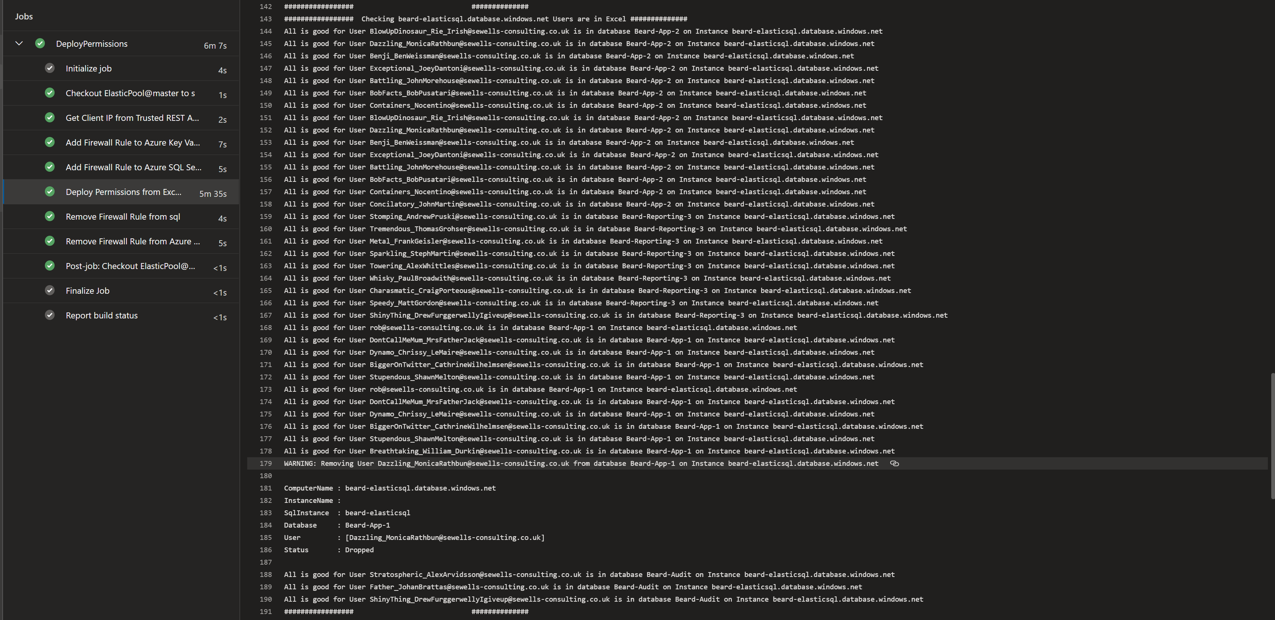
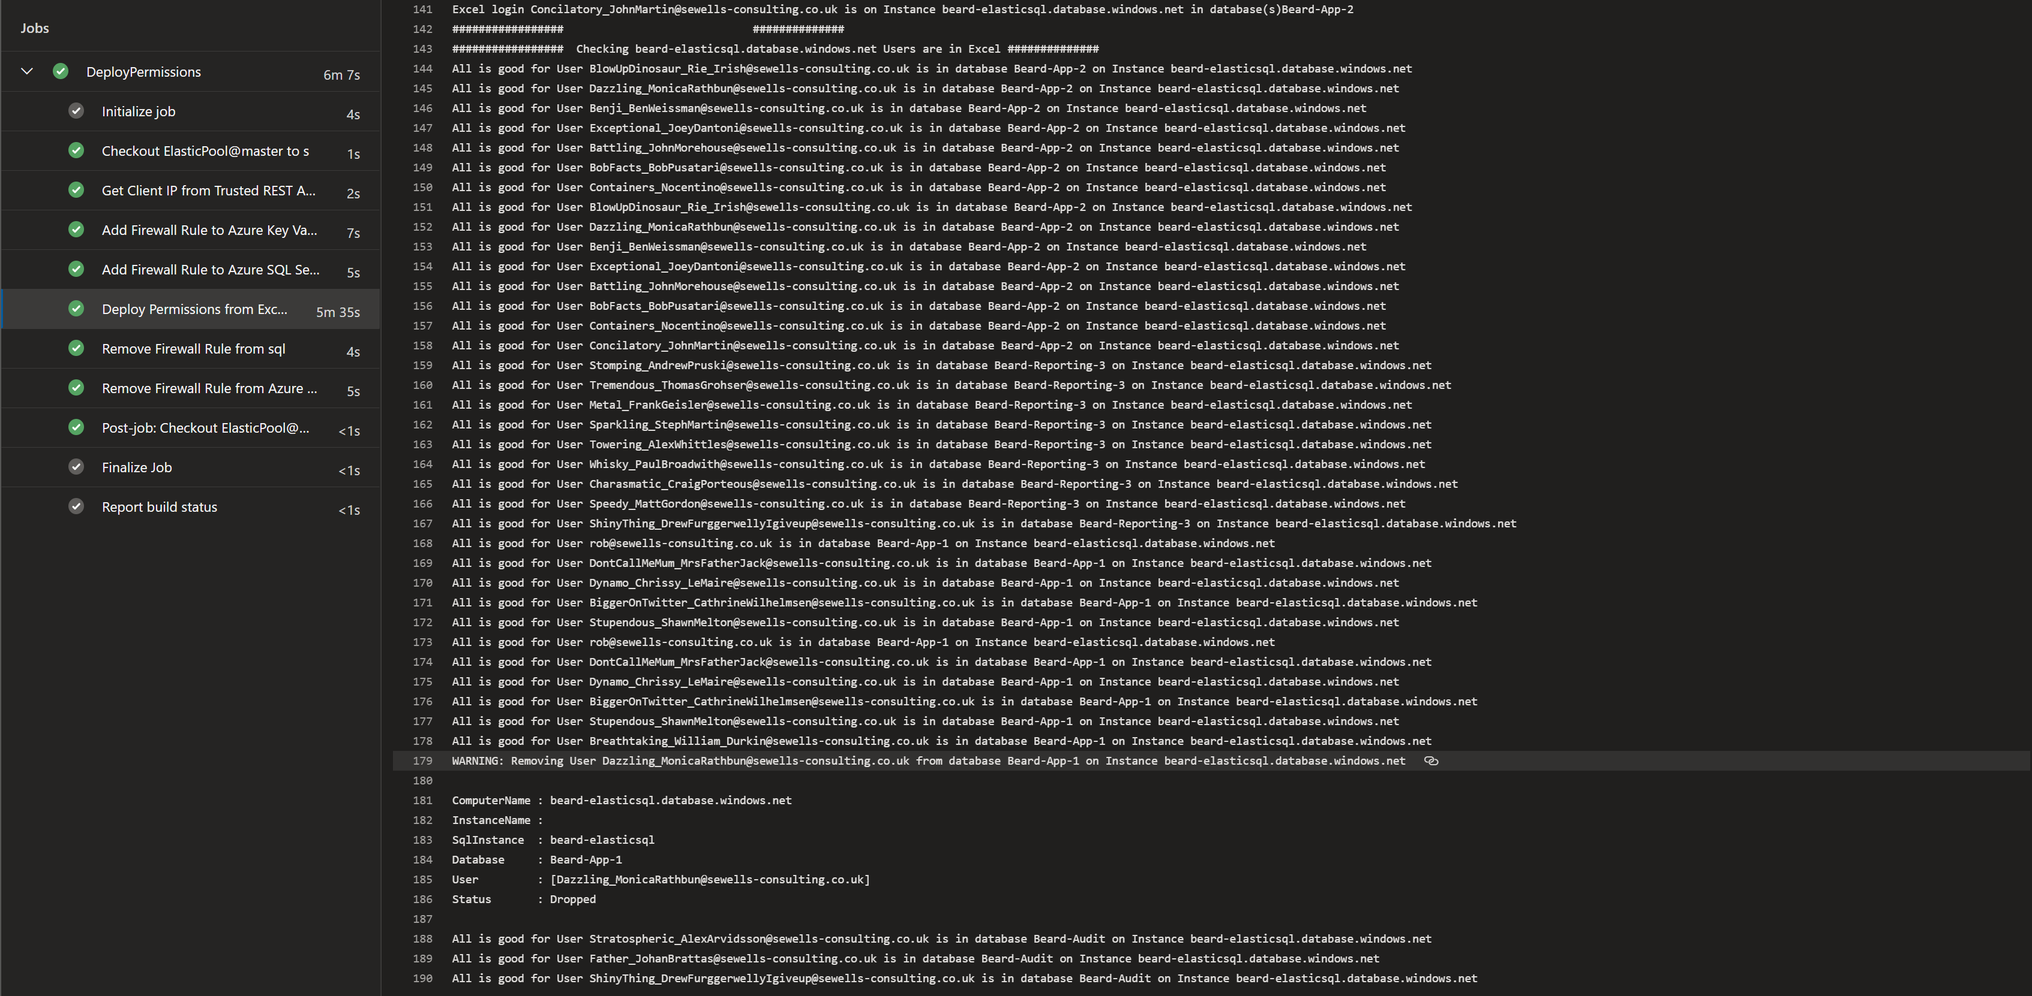
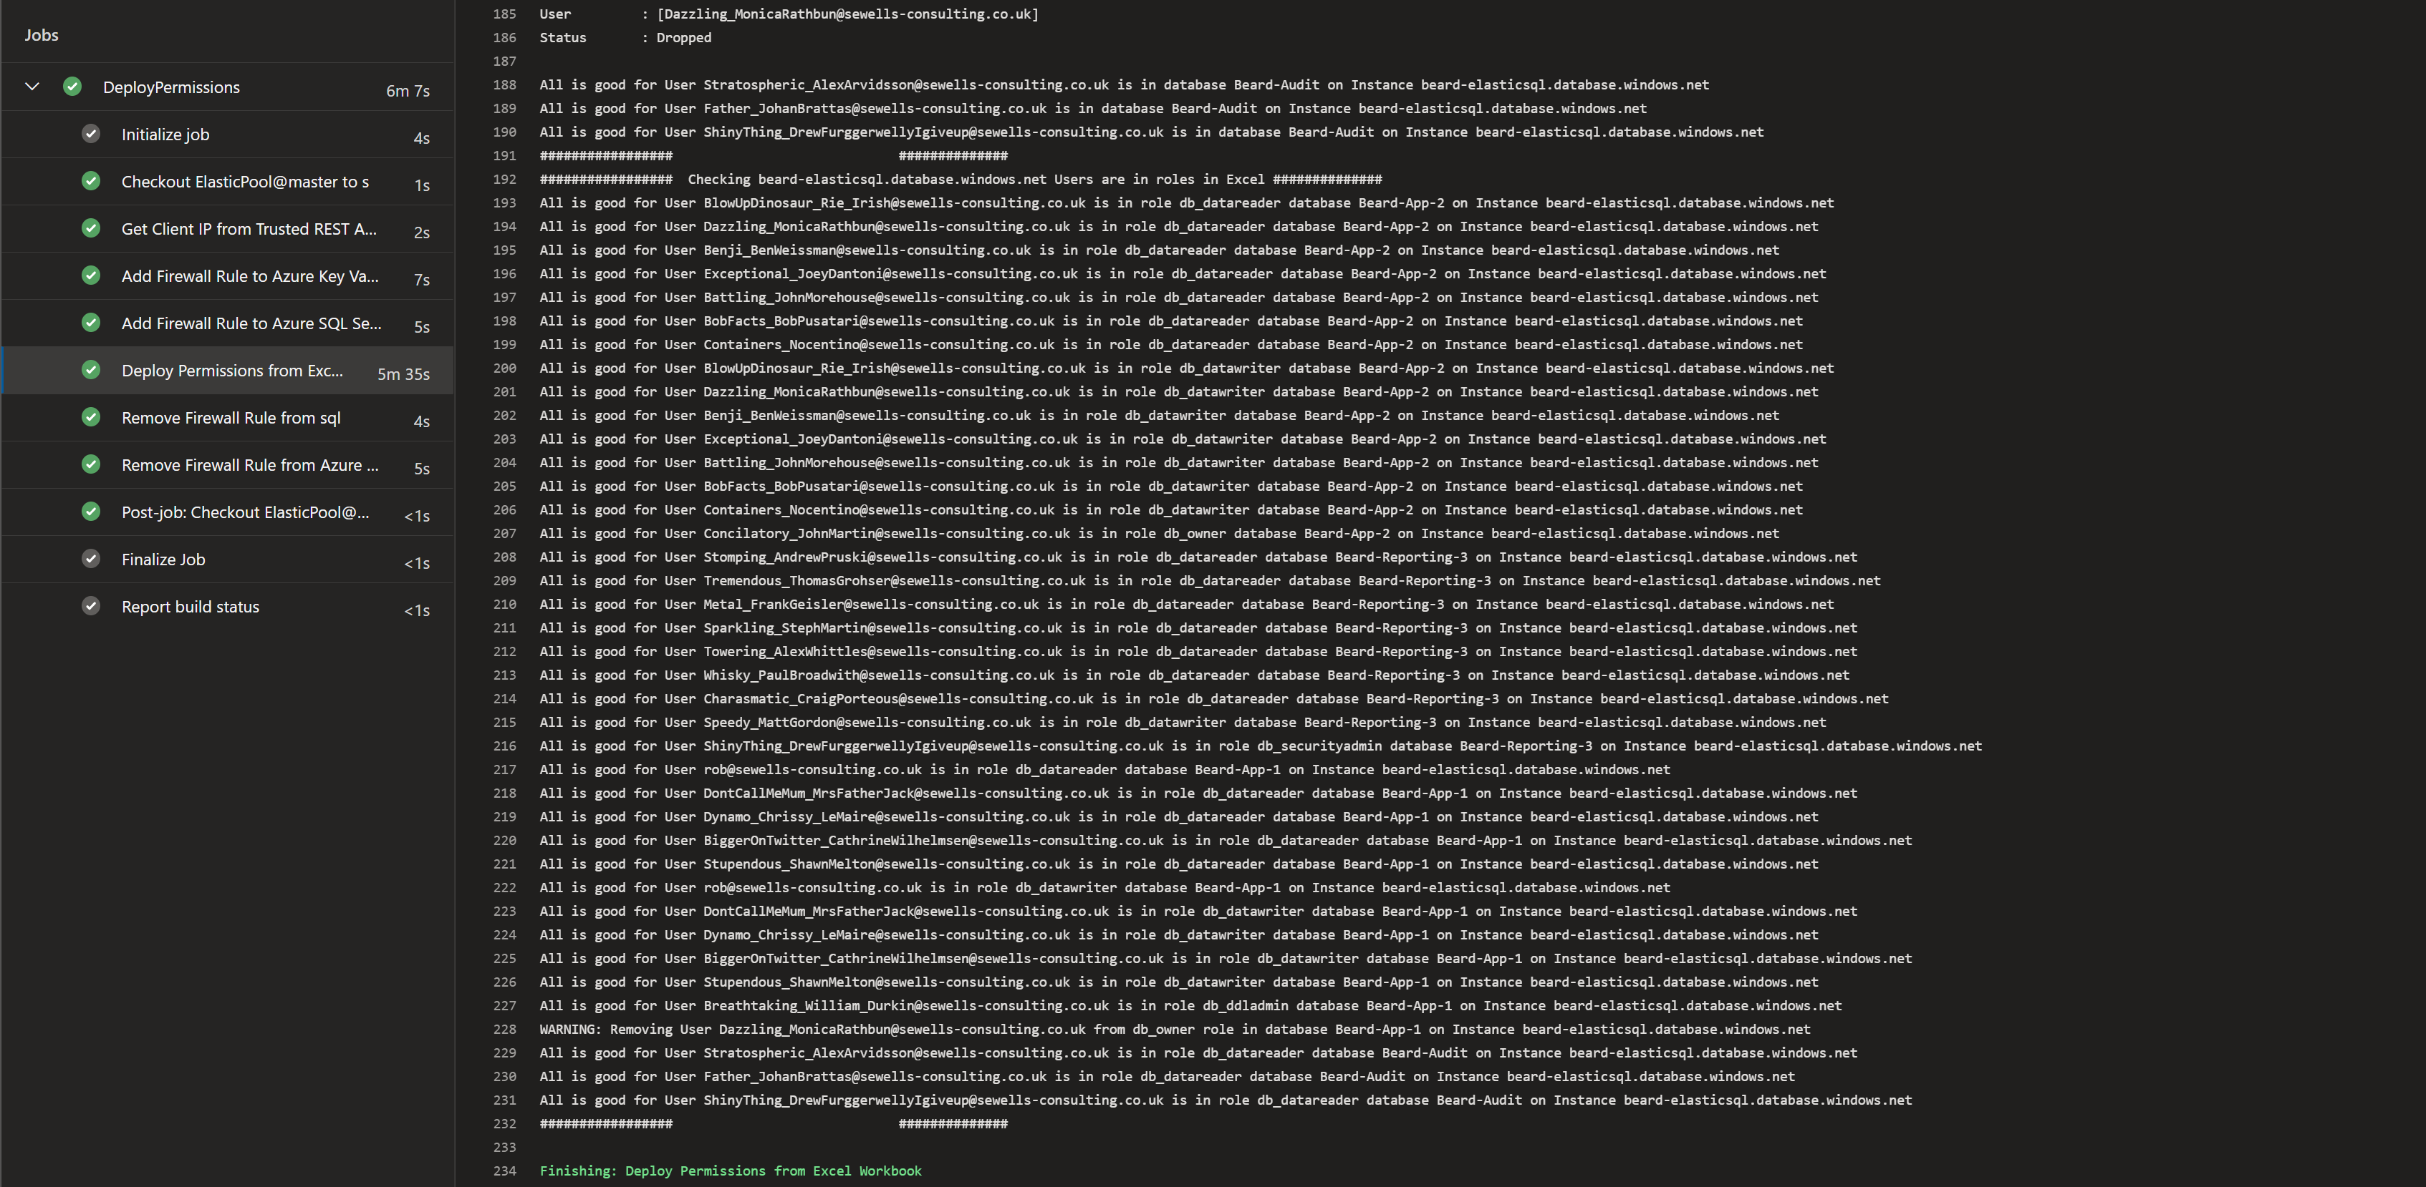
pipeline

Slide 39
pipeline

Slide 40
pipeline

Slide 41
pipeline

Slide 42
So now we have all that we need
•An Excel File for Permissions
•Azure SQL instance with AAD Identity and SPN with Directory Reader
•dbatools to run the query
•Azure Key Vault for storing secrets
•Azure DevOps for running the code

Slide 43
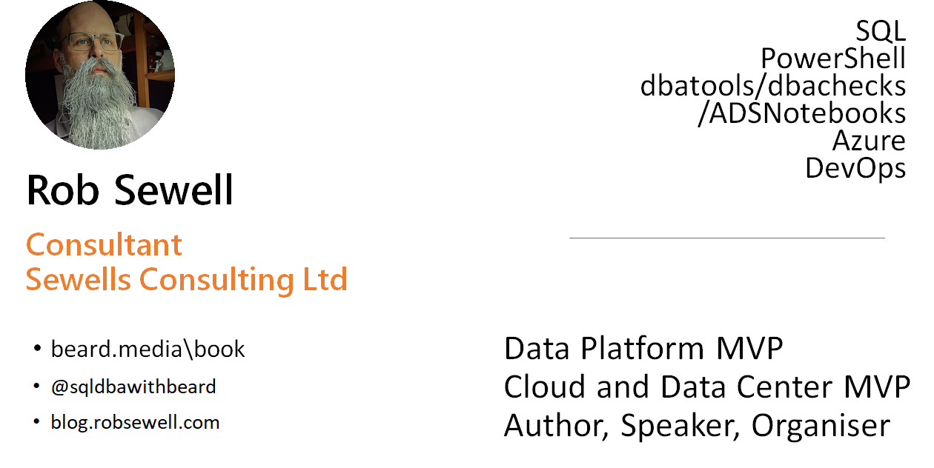
Who dis?

Slide 44
Thank You
#ScottishSummit2021

